Slide 1
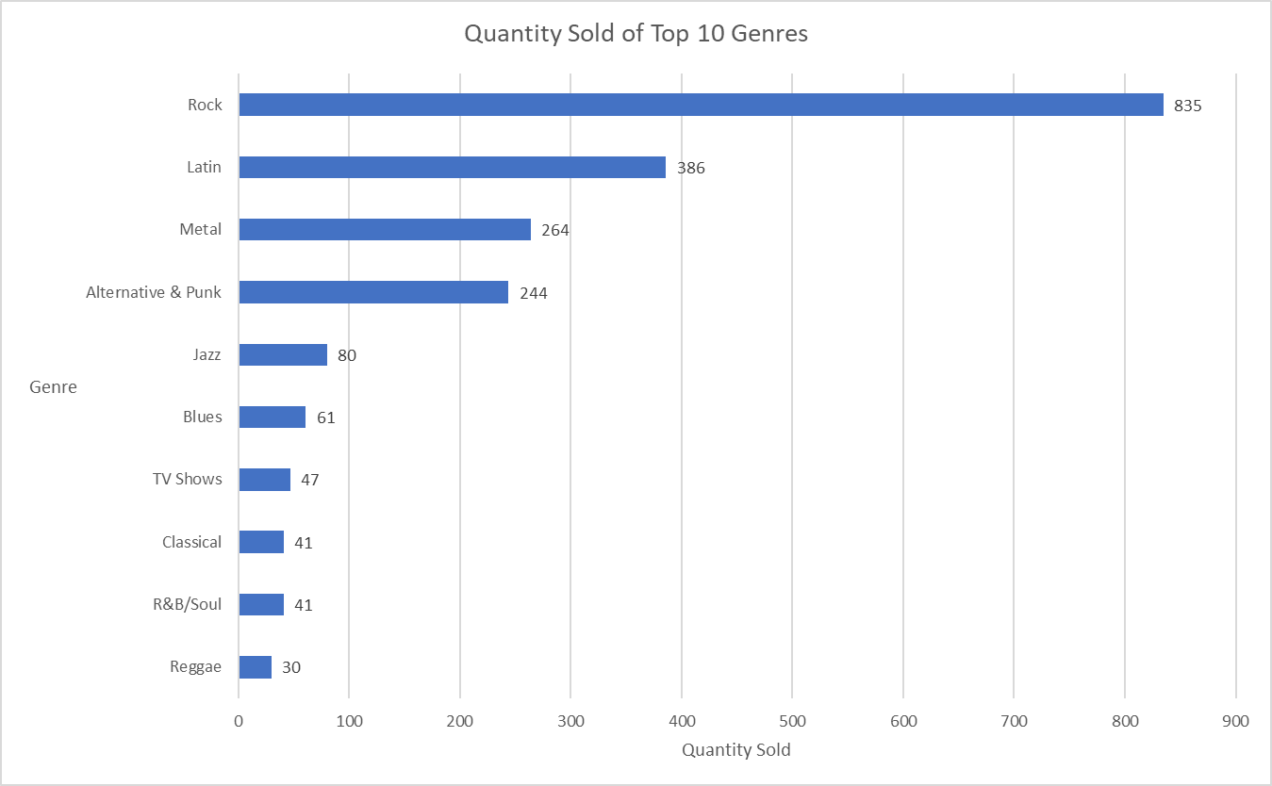
Amount of U Unit Sold of Top 10 Genres
<visualization>
We can see from the graph these are the top 10 genres that sold the most amounts. In the first place is “Rock” Genre which sold over 800 units.

Slide 2
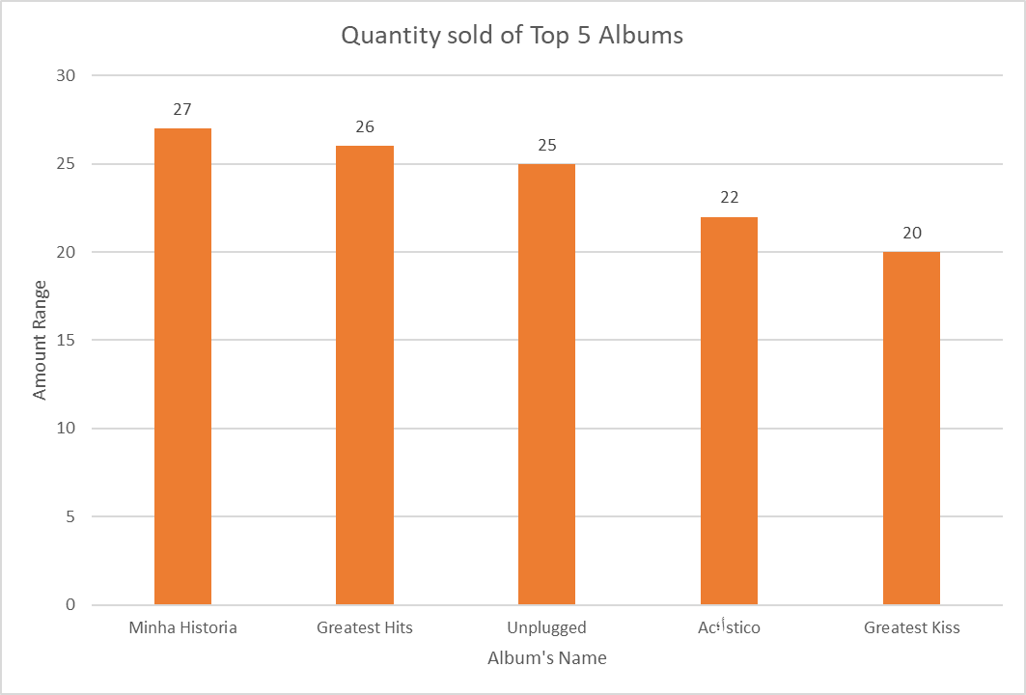
Which album sold the Most ?
<visualization>
We see from the graph that these are the top 5 albums that sold the most. In the first place is “Minha Historia” with 27 units and in the last place is “Greatest Kiss” with 20 units.

Slide 3
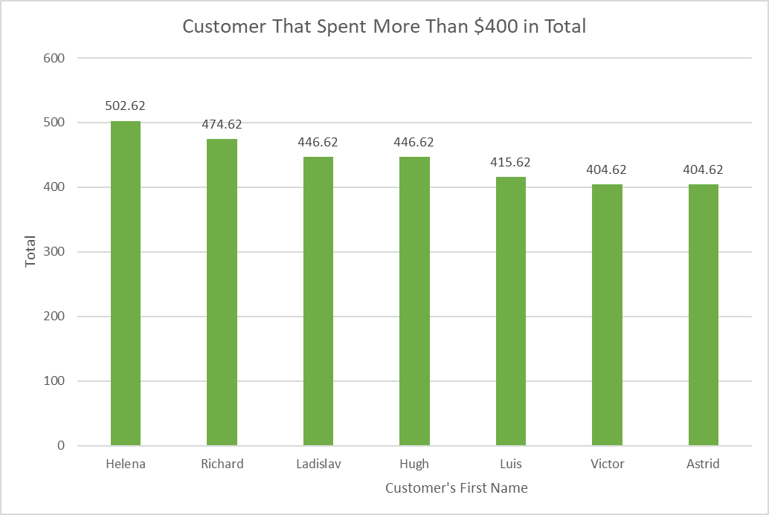
Customer that spent more than $400 in total
<visualization>
We see from the graph that these are the best customer. They spent more than $400 in total purchases.

Slide 4
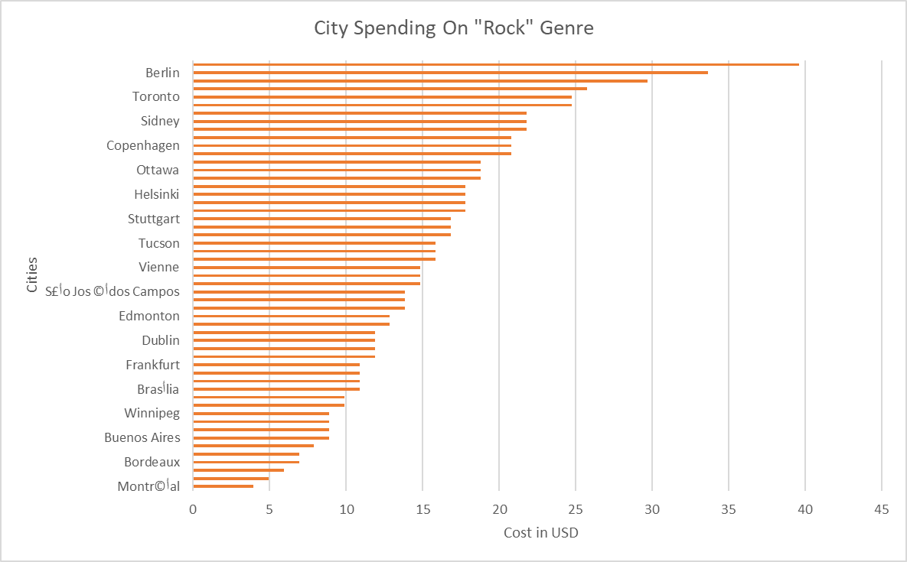
How much did Cities Spent on “Rock” Genre ?
<visualization>
We se from the graph that these are the cities that spent on “Rock” Genre.

